Slide 1
Maths Medium Term Overviews
MNP Guidance
Journal Types
1. Descriptive journaling
Descriptive questions ask children to describe the methods they have used or explain a concept.
2. Evaluative journaling
Evaluative tasks ask children why they chose a method and how helpful it was to solve the problem.
3. Creative journaling
Creative journaling lets children develop models and stories to show their understanding.
4. Investigative journaling
Children can explore a problem and record their findings.
5. Formative journaling
Children show you what they have learned and understood in formative journal entries.
Overview
Our curriculum overviews are taken from the Maths — No Problem! Primary Maths Series, which is fully aligned with the 2014 English national curriculum for maths. They outline the content and topic order of the series.
Learning is presented in small-step, logical sequences organised into individual lessons with a title indicating the focus of learning for that lesson. The sequence of lessons is carefully organised with clear lines of progression.
Spiral Curriculum
MNP Textbooks follow Bruner’s spiral curriculum, where topics are revisited at increasing levels of difficulty. New skills and concepts are clearly related to previous learning with the aim of progressively increasing competency. If pupils miss some lessons on a particular topic in one year, they’ll have a chance to revisit the topic the following year. Any key lessons missed in Year 4 can be integrated into Years 5 and 6.
For example, if Textbook 4B, Chapter 12: Geometry was missed last academic year, the lessons can be integrated into Textbook 5B, Chapter 9, which also covers geometry

Slide 2
Primary Maths Series – Reception at a Glance
 | AUTUMN TERM | SPRING TERM | SUMMER TERM
Week 1 | Number and Pattern: Matching and Sorting | Number and Pattern: Counting and Ordering | Number and Pattern: Counting on to add
Week 2 |  |  | Number and Pattern: Counting back to subtract
Week 3 | Shape, Space and Measure: Comparing and Ordering |  | Number and Pattern: Counting to 20
Week 4 | Number and Pattern: Counting up to 10 | Number and Pattern: Addition within 10 | Number and Pattern: Doubling
Week 5 |  | Number and Pattern: Comparing and Ordering | Number and Pattern: Halving and Sharing
Week 6 |  | Number and Pattern: Counting up to 10 | Number and Pattern: Odds and Evens
Week 7 | Shape, Space and Measure: Time |  | Shape, Space and Measure: Mass
Week 8 | Number and Pattern: Composition of numbers to 5 | Number and Pattern: Patterns | Shape, Space and Measure: Volume and Capacity
Week 9 |  | Shape, Space and Measure: Measuring height and length | Shape, Space and Measure: Money
Week 10 | Shape, Space and Measure: 2D Shapes Positional Language | Shape, Space and Measure: Capacity | Number and Pattern: Data
Week 11 |  | Shape, Space and Measure: 2D Shape | Consolidation
Week 12 |  | Shape, Space and Measure: 3D Shape | Number and Pattern: Word Problems

Slide 3
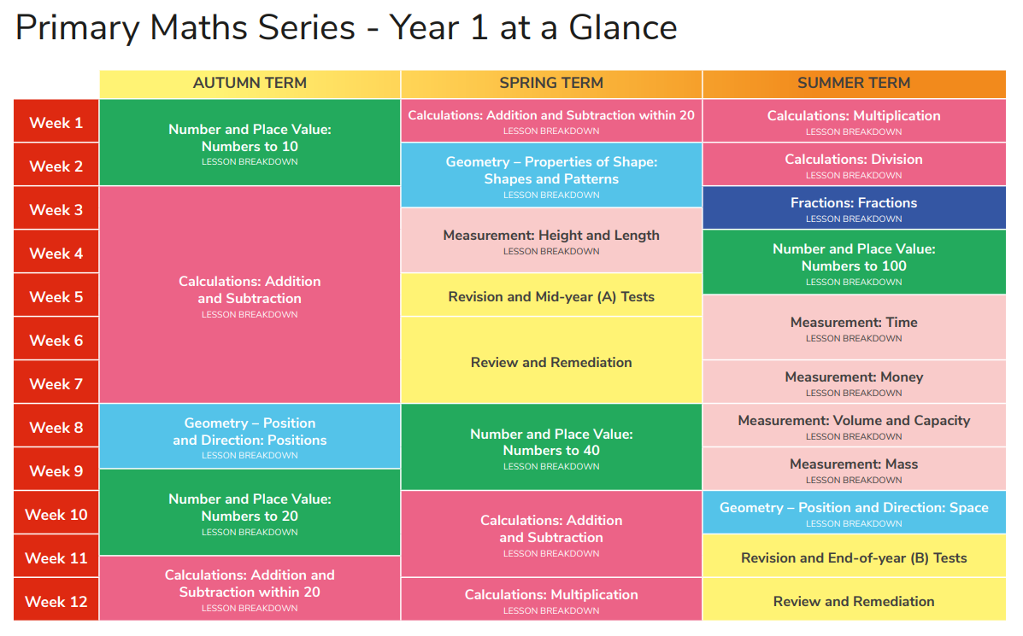

Slide 4
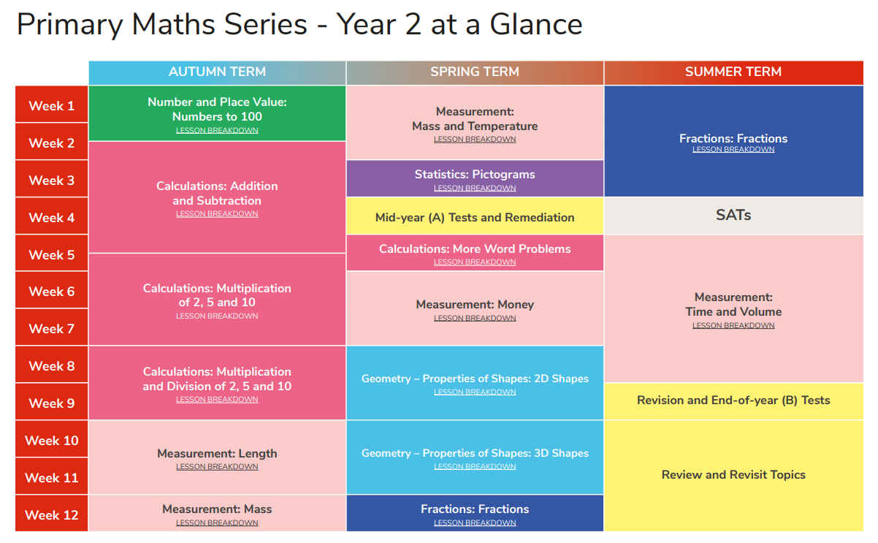

Slide 5
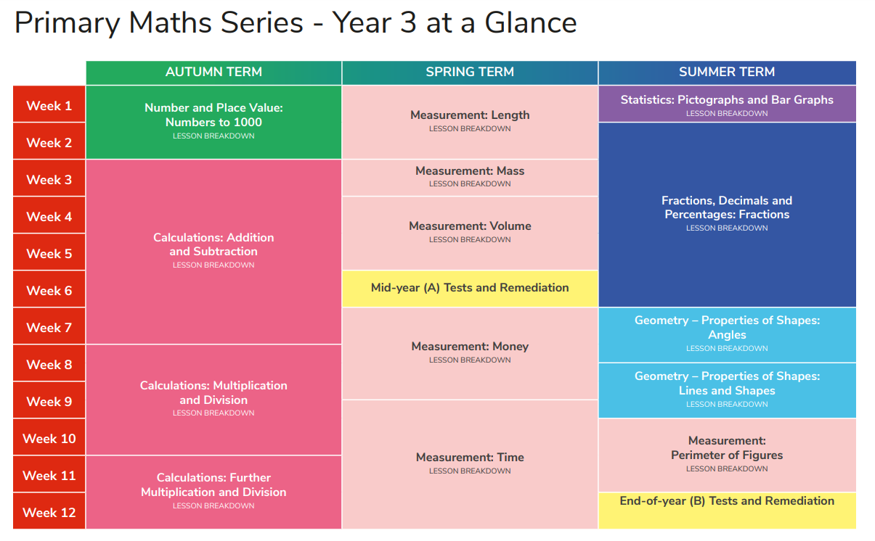

Slide 6
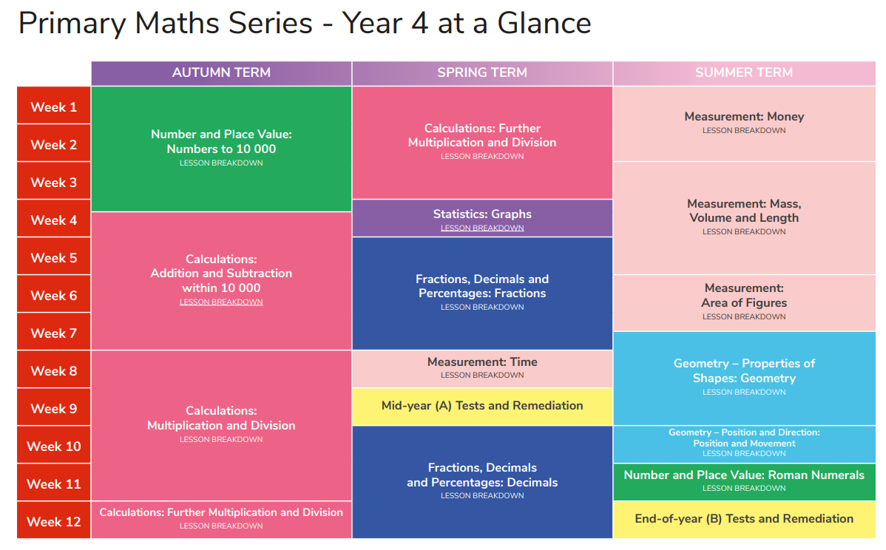

Slide 7
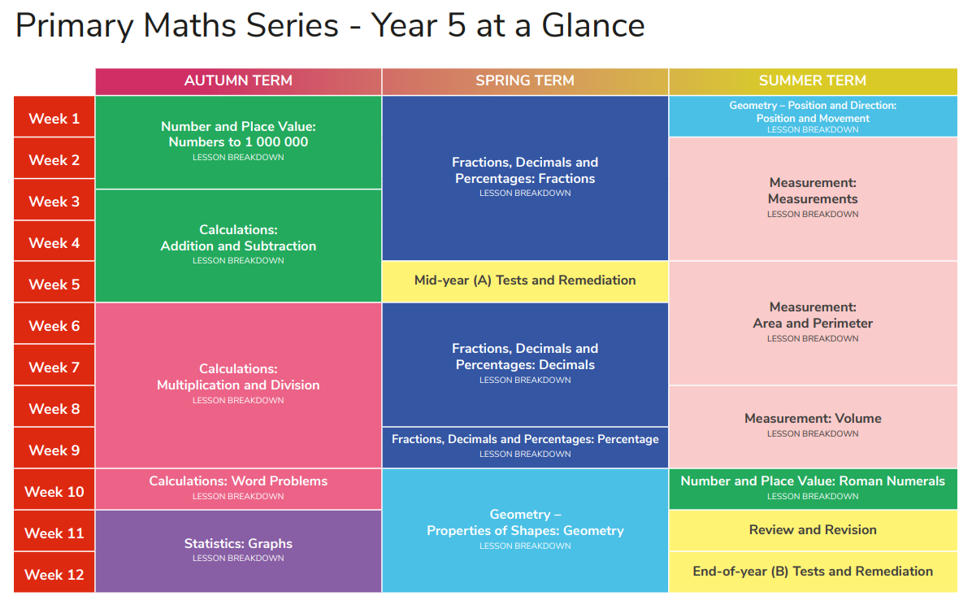

Slide 8
